Slide 1
Terminologies

Slide 2
Shared variables in spark
A copy of shared variable goes on each node of the cluster when the driver sends a task to the executor on the cluster, so that it can be used for performing tasks.
Broadcast Variables: Broadcast variables allow the programmer to keep a read-only variable cached on each machine rather than shipping a copy of it with tasks. They can be used to give every node a copy of a large input dataset in an efficient manner
> val broadcastVar1 = sc.broadcast(Array(1, 2, 3))
Accumulators : Accumulators are variables that are only added through an associative and commutative operation. They are used to implement counters or sums
val accum1 = sc.longAccumulator("Accumulator1")
sc.parallelize(Array(1, 2, 3, 4)).foreach(x => accum.add(x))

Slide 3

Spark Streaming Overview
Scaling
Speed
Fault Tolerance
Integration
Business Analysis

Slide 4
Spark Streaming Fundamentals
Streaming Context: A Streaming Context object can be created from a SparkContext object.
Dstream: is the basic abstraction provided by Spark Streaming
Caching: DStreams allow developers to cache/ persist the stream’s data in memory
Accumulators, Broadcast Variables and Checkpoints
Streaming data sources
Batch data sources
sparkmlib and spark sql
Data storage systems

Slide 5

DSTREAM
Discretized Stream (DStream) is the basic abstraction provided by Spark Streaming. It is a continuous stream of data.

Slide 6

Transformations on DStreams:

Slide 7
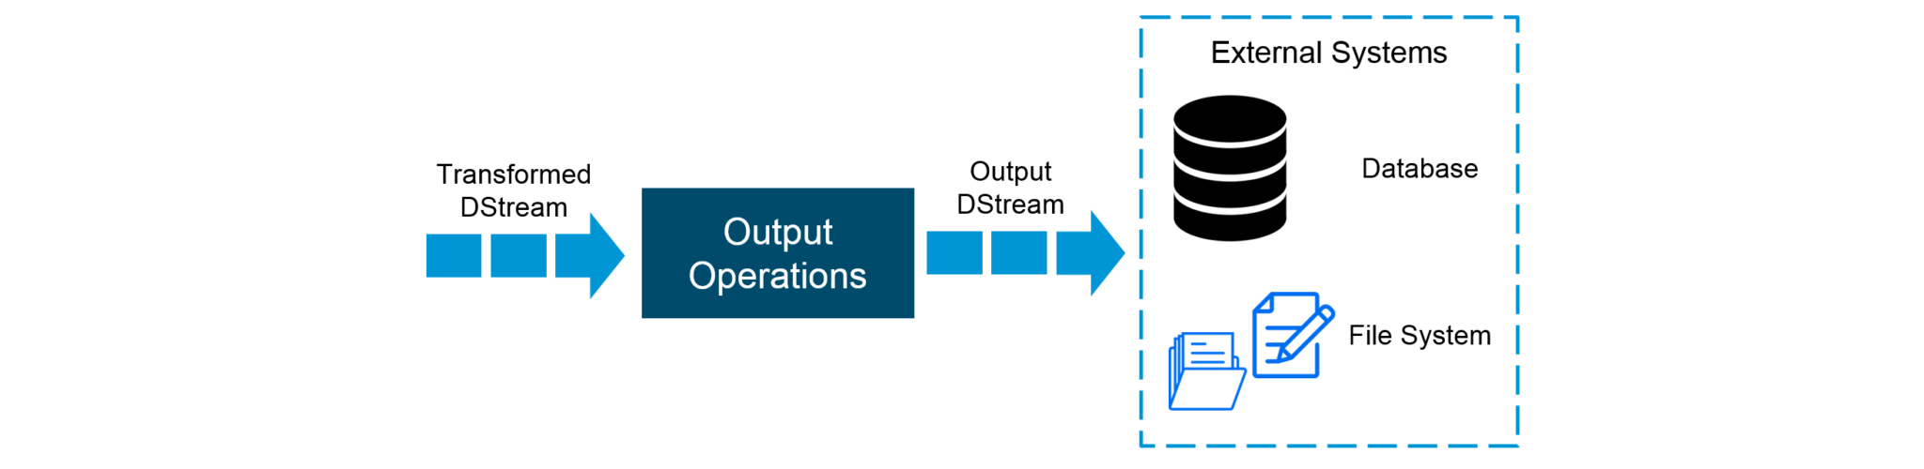
Output DStreams:
Output operations allow DStream’s data to be pushed out to external systems like databases or file systems.

Slide 8
Messaging System
A Messaging System is responsible for transferring data from one application to another, so the applications can focus on data, but not worry about how to share it.

Slide 9
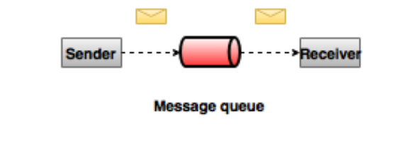
Point to Point Messaging System
Messages are persisted in a queue.
One or more consumers can consume the messages in the queue, but a particular message can be consumed by a maximum of one consumer only.

Slide 10
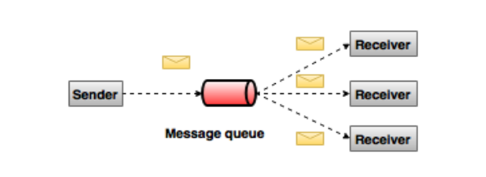
Publish-Subscribe Messaging System
Messages are persisted in a topic.
Message producers are called publishers and message consumers are called subscribers.
Consumers can subscribe to one or more topic and consume all the messages in that topic

Slide 11
What is Kafka?
Apache Kafka is a fast, scalable, fault-tolerant, distributed publish-subscribe messaging system and a robust queue that can handle a high volume of data and enables you to pass messages from one end-point to another.

Slide 12
Benefits
Reliability
Scalability
Durability
Performance

Slide 13
Use cases
Activity Tracking
Log Aggregation Solution
Real time Processing

Slide 14
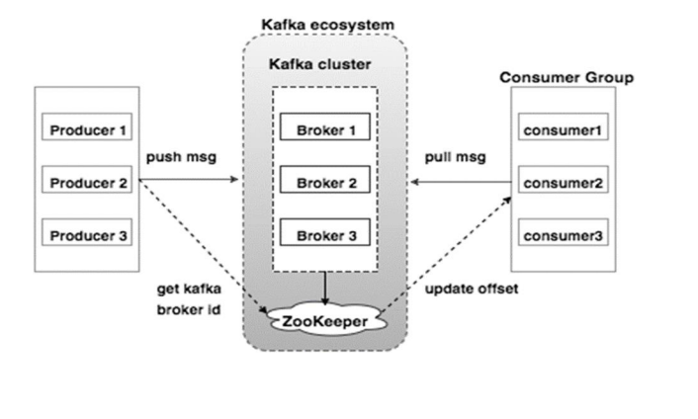
Kafka Architecture

Slide 15
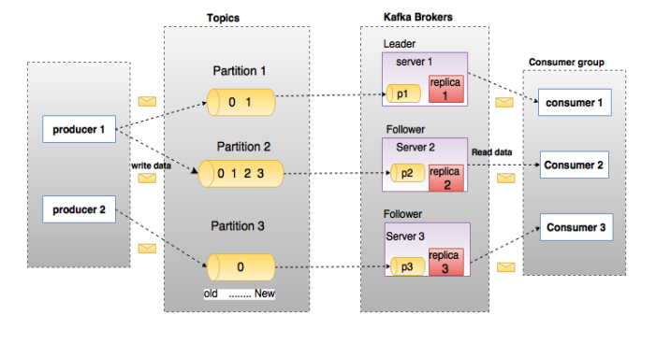

Slide 16
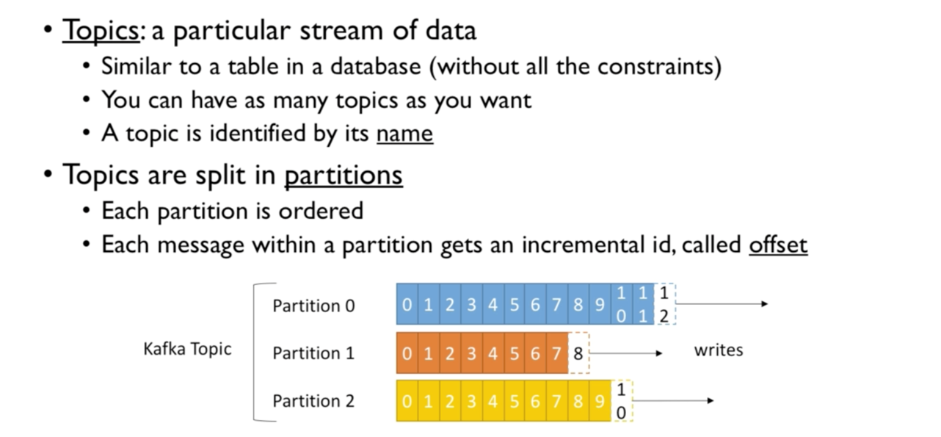
Topics

Slide 17
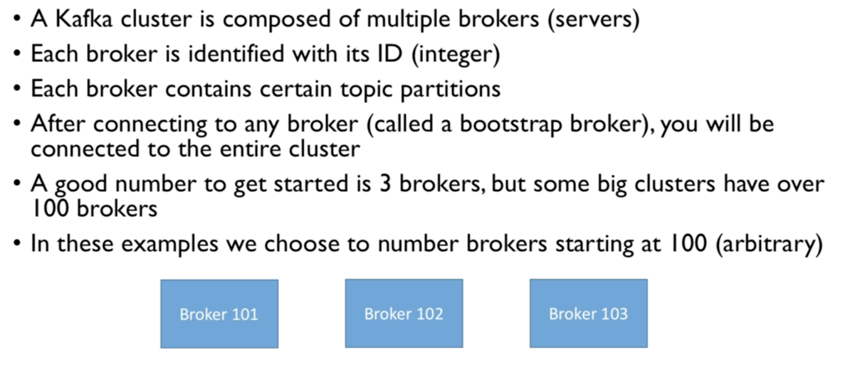
Brokers

Slide 18
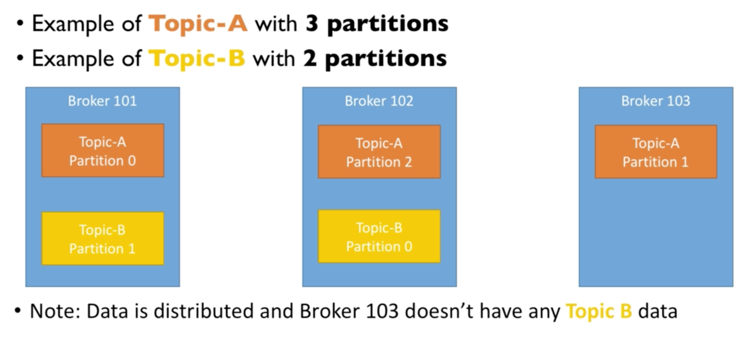

Slide 19
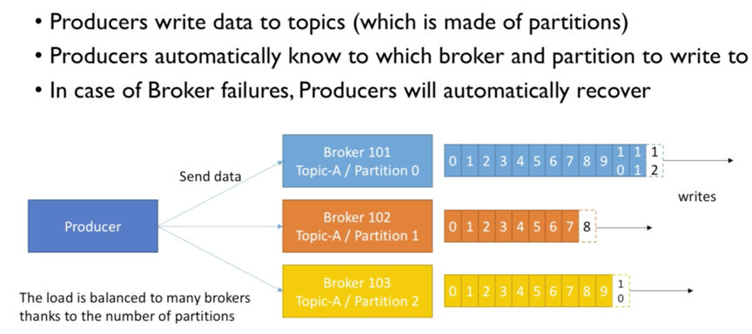
Producers

Slide 20
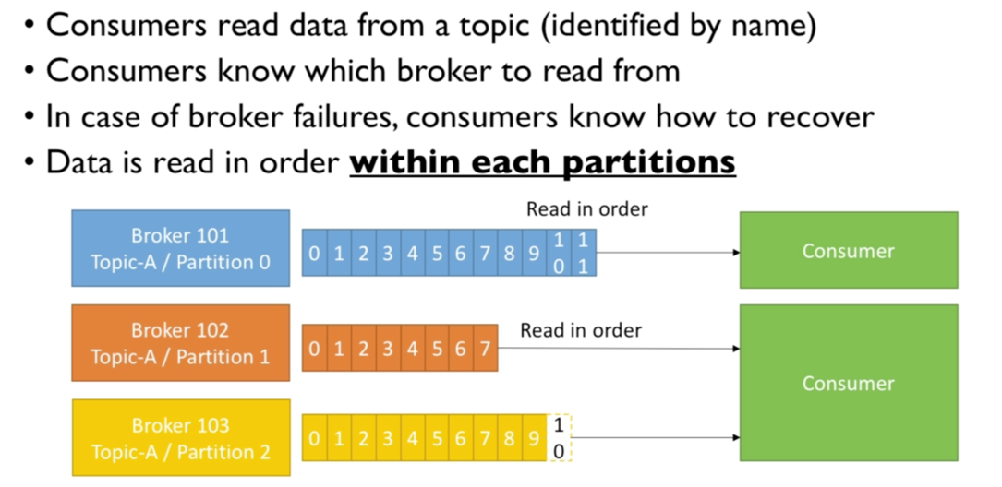
Consumers

Slide 21
Four core APIs in Apache Kafka
Kafka Producer API: This Kafka Producer API permits an application to publish a stream of records to one or more Kafka topics.
Kafka Consumer API: To subscribe to one or more topics and process the stream of records produced to them in an application, we use this Kafka Consumer API.
Kafka Streams API: In order to act as a stream processor consuming an input stream from one or more topics and producing an output stream to one or more output topics and also effectively transforming the input streams to output streams, this Kafka Streams API gives permission to an application.
Kafka Connector API: This Kafka Connector API allows building and running reusable producers or consumers that connect Kafka topics to existing applications or data systems.

Slide 22
Basic Operations
Creating a Kafka Topic − Kafka provides a command line utility named kafka-topics.sh to create topics on the server.
bin/kafka-topics.sh --create --zookeeper localhost:2181 --replication-factor 1 --partitions 1 --topic topic-name
bin/kafka-topics.sh --create --zookeeper localhost:2181 --replication-factor 1 --partitions 1 --topic welcome-kafka
Start Producer to Send Messages:
$ bin/kafka-console-producer.sh --broker-list localhost:9092
--topic Hello-Kafka[2023-11-6 13:50:45,931]
Hello
My first message
Start Consumer to receive Messages:
bin/kafka-console-consumer.sh --zookeeper localhost:2181 —topic Hello-Kafka --from-beginning

Slide 23
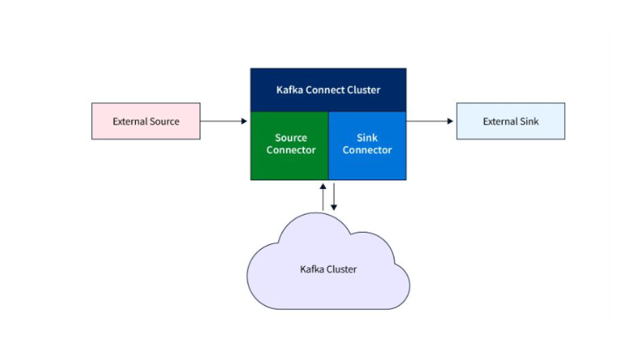
Kafka connect

Slide 24
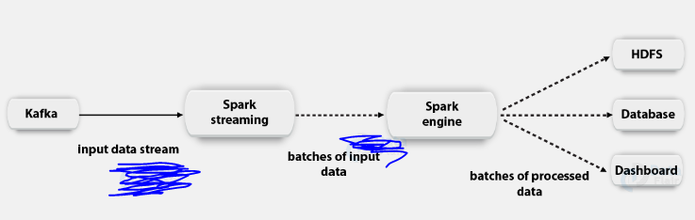
What is Kafka Spark Streaming Integration?

Slide 25
Approaches
Receiver-Based Approach: uses a receiver to receive data in spark executors.
Direct Approach (No Receivers): It ensures stronger end-to-end guarantees. This approach periodically queries Kafka for the latest offsets in each topic partition, rather than using receivers to receive data.
Key Kafka Spark APIs
StreamingContext API: main entry point for utilizing the Spark Streaming functionality.
SparkConf API: represents the configuration for a Spark application
KafkaUtils API: allows you to connect Kafka clusters to Spark streaming and set up the Spark Streaming and Kafka Integration
Two important methods:
--- createStream: It is used to create an input stream that pulls messages from the Kafka broker
---createDirectStream. It is used to create an input stream that fetches messages directly from the Kafka broker without using a receiver.

Slide 26
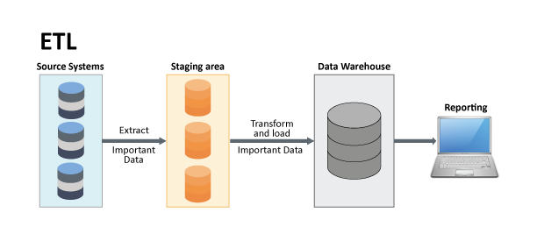
ETL
Extract – The process of pulling data from storage such as a database
Transform – The process of putting all data in to common format
Load – The process of loading data in to software for analysis

Slide 27
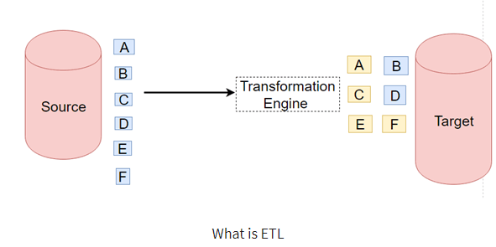
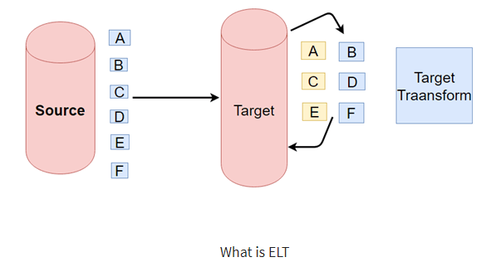
ETL vs ELT

Slide 28
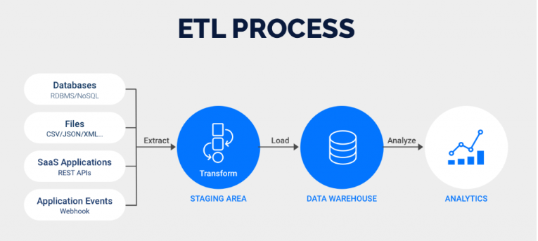
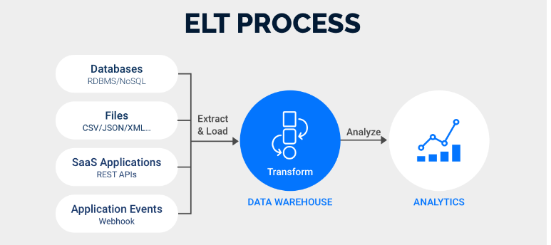

Slide 29
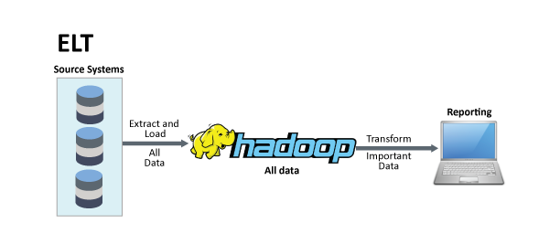
ELT in big data

Slide 30
Exploratory Data Analysis (EDA)
To investigate data sets and
• summarize their main characteristics, often employing data
visualization methods.
• To determine how best to manipulate data sources to get the answers
you need, making it easier for data scientists to discover patterns, spot
anomalies, test a hypothesis, or check assumptions.
• Goals of EDA: Data Cleaning and Descriptive Statistics

Slide 31
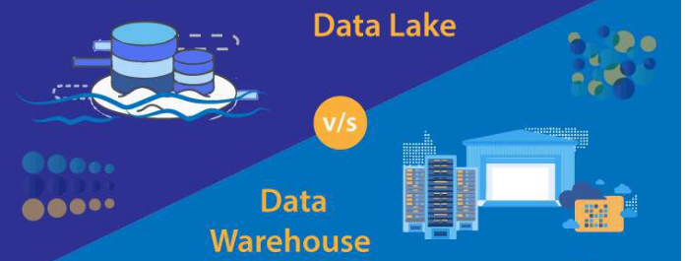
Data Warehouse and Data Lakes
Data warehouses are used for analyzing archived structured data
Data lakes are used to store big data of all structures.

Slide 32
Data Warehouse Concept:
Data Extraction
Data Cleaning
Data Transformation
Data Loading and Refreshing

Slide 33
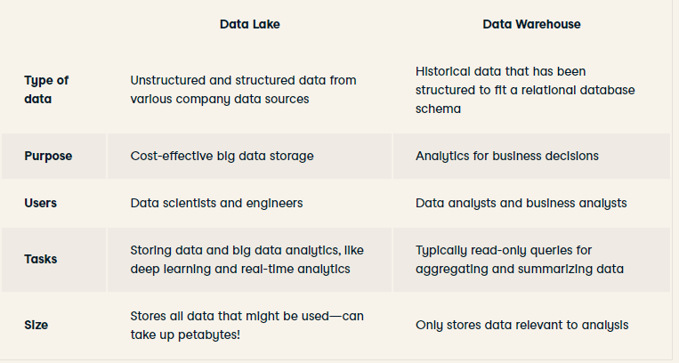
Data Lakes vs Datawarehouse

Slide 34
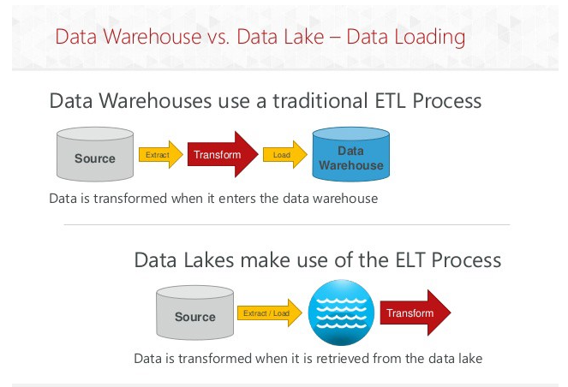
Data Loading

